Slide 1
HOW TO EXCEL
AS A GREAT
MENTOR & MENTEE

Slide 2
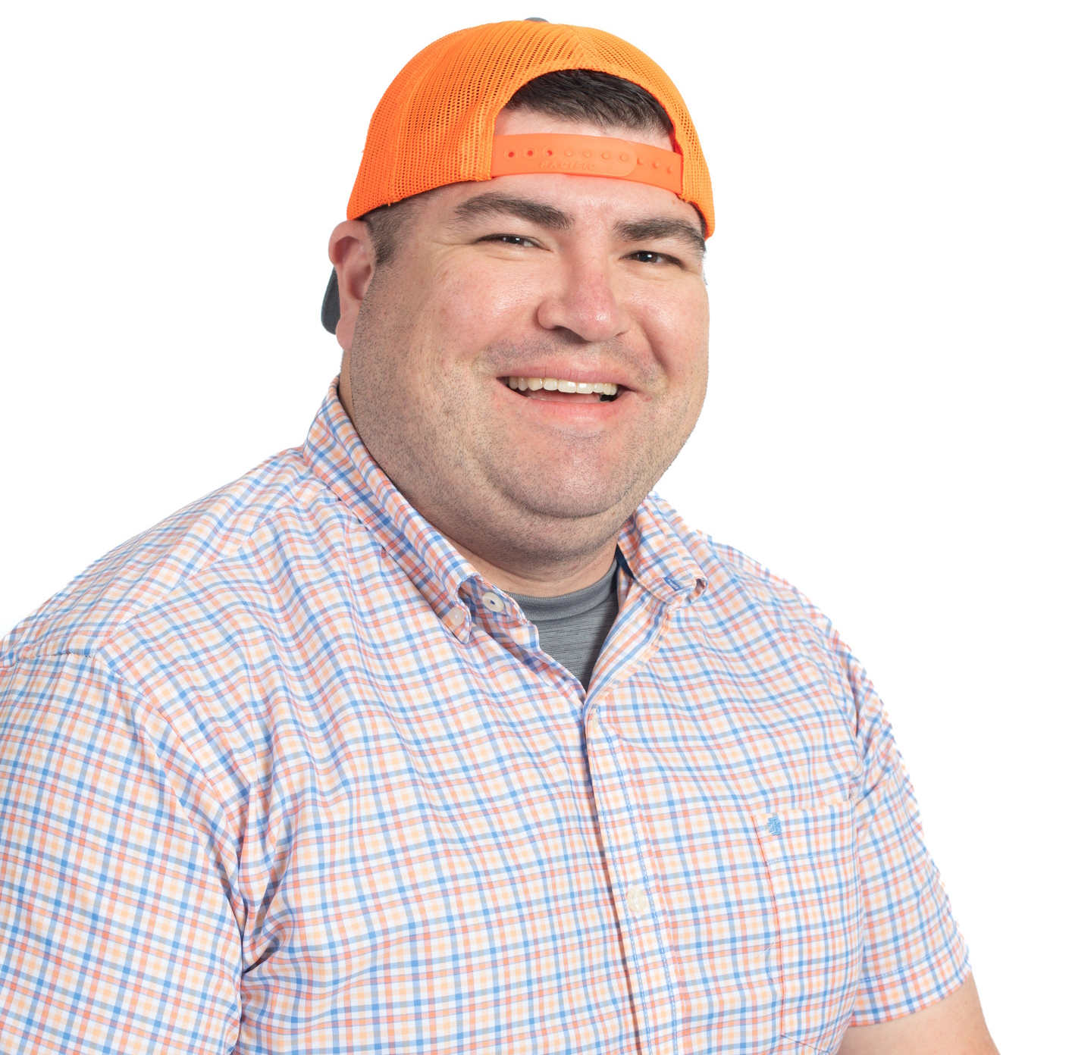
HOWDY
I’m Joe Houghes
I am here as a User Group leader & I love to get people engaged and learning.
You can find me at @jhoughes or fullstackgeek.net
https://bit.ly/VMUG-Mentoring

Slide 3









Who am I?
Sr. Solutions Architect @ Pure Storage
Co-leader – Denver PowerShell & VMware User Groups
Serial collector of Communities, now an International speaker (huzzah!)
Find me: Green Orange Colored hat, big grin & the loud "Howdy Y'all."
I have little (no) shame, and try to share my learnings with others
Push yourself, Learn more, Don’t fear sharing
Share YOUR knowledge (Perspective is important)
Teach whatever you can (Be The Master – Don Jones)
Job vs Career
Don’t let any of this scare you!
Even I’ll screw this up, and we’ll all survive…

Slide 4
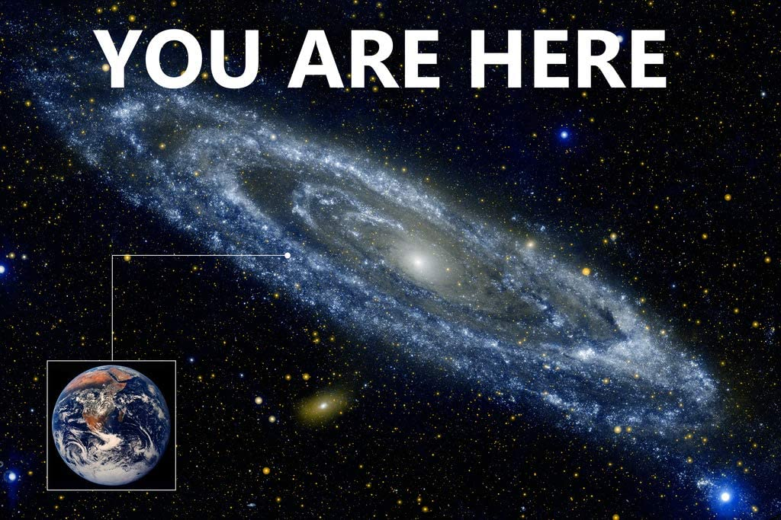
AT THE START

Slide 5

WHAT’S THE REASON YOU ARE HERE
Mentor or
Mentee?
Single focus, or more to share?
What do you really want to achieve?

Slide 6

ACHIEVING RESULTS
Best Chance
Open Exchange
It’s NOT About You
The Whole Person

Slide 7

KNOW WHO YOU ARE
Start with you
Learn who
Define a goal

Slide 8
BE THE MASTER

Slide 9
You see, the point of a Master is not to know it all.
The point of a Master is to teach.
To share.
To pass on.

Slide 10
BE THE MASTER YOURSELF
Be the Mentor
Be the Mentee

Slide 11
REGULAR PROGRESS THROUGH REGULAR CADENCE
Regular is the Key
Evaluation is Necessary

Slide 12
REACHING THE END

Slide 13
BENEFITS FROM MENTORING
For the Mentee
For the Mentor

Slide 14
CHALLENGES WE FACE
Lack of definition
Lack of openness
Lack of connection
Lack of time

Slide 15
CLOSING THE LOOP
Early separation
Completion or pause for effect
Planning for follow-up
If things don’t work…

Slide 16
THANKS!
Any questions?
You can find me:
@jhoughes (Twitter)
fullstackgeek.net (Blog)
or joe@fullstackgeek.net

